Slide 1
Bayesian Optimization for Chatbot Satisfaction
Naveen Aliveli
Karthik Katepally
Jianlin Lin

Slide 2
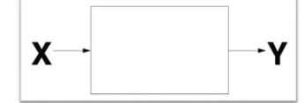
Goal:
To discover x that maximizes Y
Global Optimization
Introduction:
Our team of AI engineers is dedicated to optimizing the chatbot's performance and user satisfaction.
To leverage Bayesian optimization with Gaussian Process Regression to identify optimal configuration parameters for maximizing user satisfaction.

Slide 3
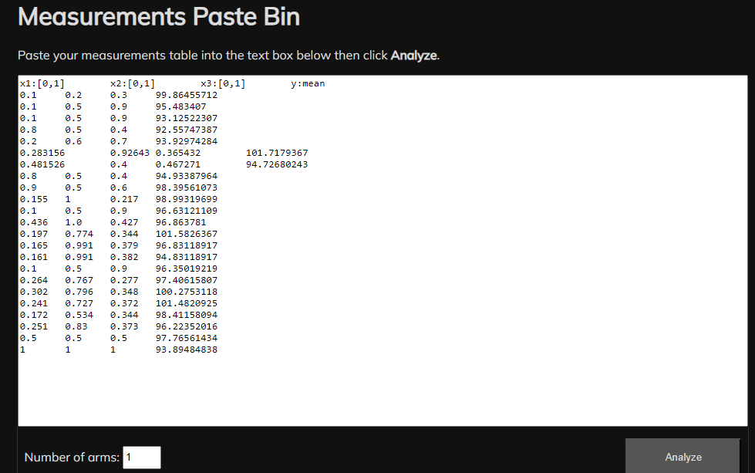
Data Collection
The measurements are collected using one of the Bayesian Optimization tools i.e., Cogneato http://cogneato.xyz which provided us with a measurement/day
Cogneato provides us with x1, x2, and x3 metrics.
By using these generated metrics, measurements
were collected from the server running at:
http://44.202.108.53:8080/?sid=59265&x=0.1,0.2,0.3

Slide 4
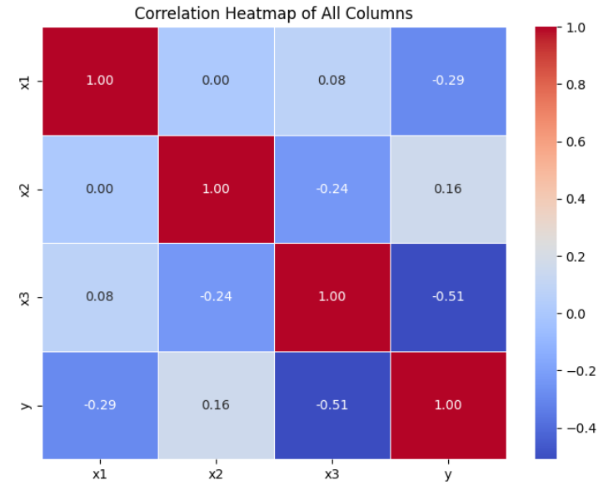
Data Analysis
To check the correlation between the metrics we plot a correlation matrix.
We observed from the heat map that there’s
negative correlation between the variables x1 and
x2

Slide 5
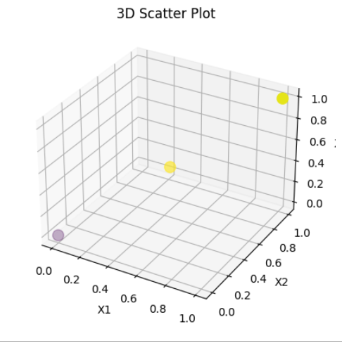
3D Scatter Plot of Business Metric Values
The plot aims to explore the relationship between
three configuration parameters (X1, X2, and X3)
and the corresponding business metric (Y).
The data points are scattered in 3D space,
and their colors are based on
the business metric values (Y).
The size of the points in the scatter plot
is set to 100 for better visibility.

Slide 6
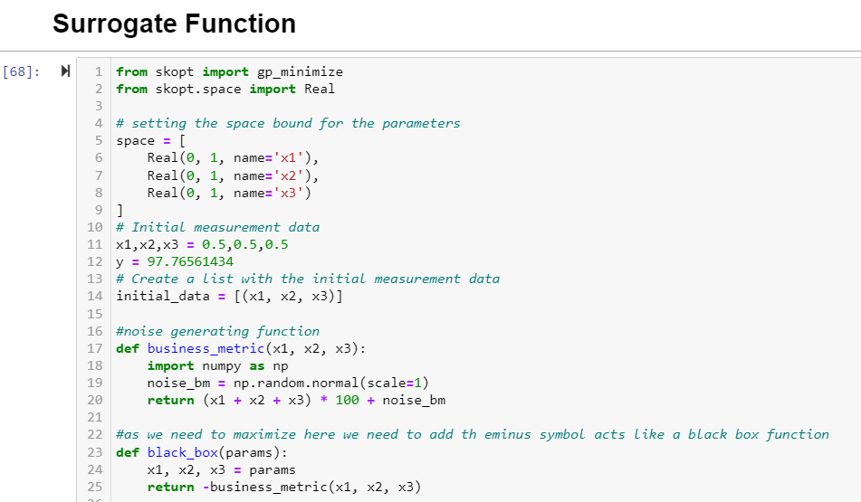
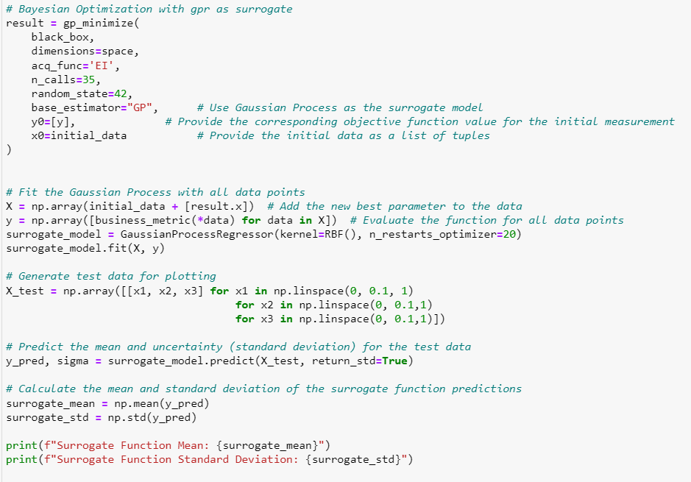
Gaussian Process Regressor (GPR): Surrogate Model

Slide 7
We use Bayesian Optimization with the Gaussian Process Regressor (GPR) as the surrogate model to maximize the business metric (user satisfaction).
The optimization process runs for 35 iterations, and the 'Expected Improvement' acquisition function is used to guide exploration.
The best configuration parameters found during optimization are used to update the surrogate model and refine our predictions.
We visualize the surrogate model's predictions by generating test data and plotting the mean and uncertainty (standard deviation) of the surrogate function.
The optimization process helps us iteratively explore and optimize the chatbot's configuration, leading to improved user satisfaction over time.

Slide 8
Surrogate models using three different built-in kernels:
RBF (Radial Basis Function),
Matern, and
RationalQuadratic
The predictions and uncertainties for each kernel are compared to assess which kernel is better suited
for approximating the underlying relationship between configuration parameters and the business metric.
The choice of kernel impacts the surrogate model’s flexibility and it is essential to choose a kernel that best captures the underlying patterns in the data.

Slide 9
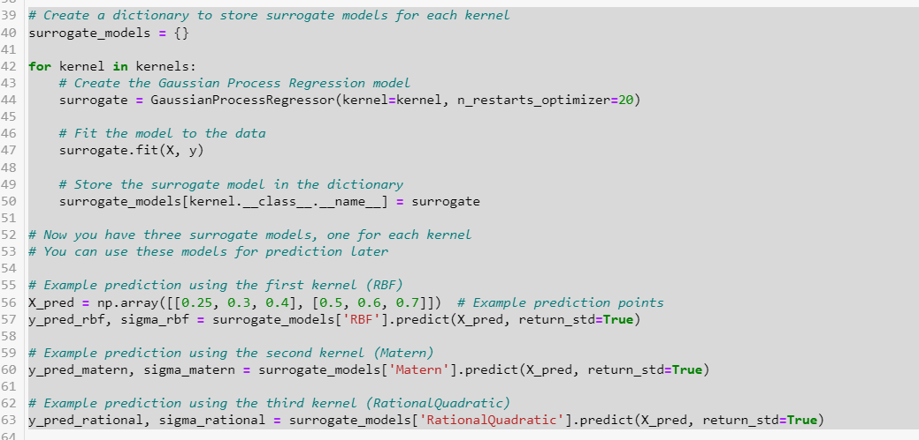
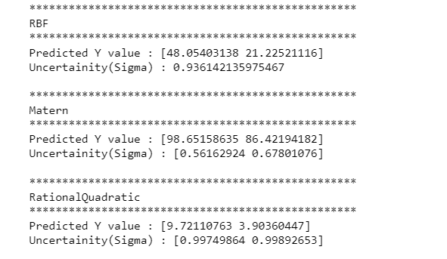
Define three kernel functions (RBF, Matern, RationalQuadratic) that determine the shape and flexibility of the Gaussian process.
Iterate over the three kernel functions and creates Gaussian Process Regression models (surrogate models) with each kernel.
The models are trained on the dataset using the 'fit' function.
Use the trained surrogate models to predict user satisfaction values ('y_pred') and their corresponding uncertainties ('sigma') for new input configurations ('X_pred’).
Predictions and uncertainties are obtained for each kernel separately.

Slide 10
Upper Confidence Bound Optimization(UCB)
UCB is a widely used exploration-exploitation strategy in optimization to balance the trade-off between exploring new configurations and exploiting known promising configurations.
The UCB function aims to maximize the mean of the predicted value and the uncertainty (standard deviation) estimated by the GPR.
The code uses the 'minimize' function from SciPy to optimize the UCB function with the surrogate models for each kernel.
The optimization is performed with initial parameters set to [0.5, 0.5, 0.5] within the defined bounds.

Slide 11
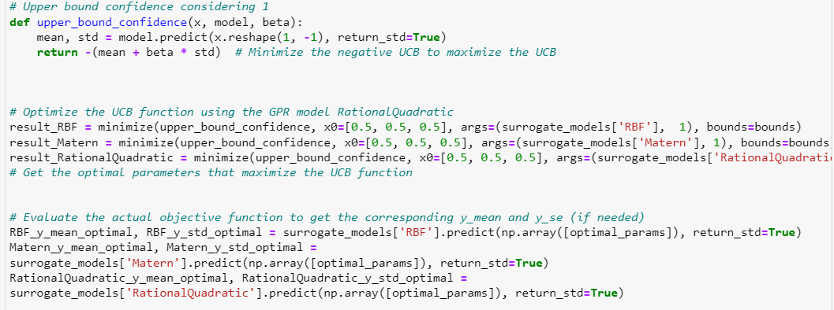
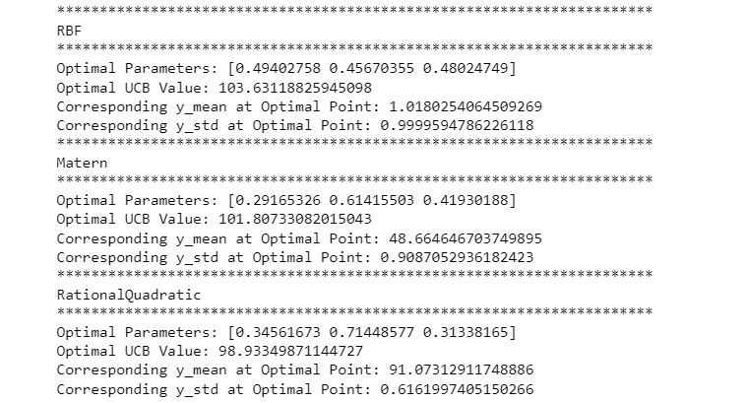

Slide 12
Conclusion
Optimal Parameters to maximum business metric:
X1, x2,x3: [0.49402758 0.45670355 0.48024749]
Y_{max} : 103.63118825945098
We estimated that the above values for parameters X₁, X₂, X₃ allow us to make the most of the chatbot user satisfaction level.

Slide 13
References
https://towardsdatascience.com/bayesian-optimization-a-step-by-step-approach-a1cb678dd2ec
https://machinelearningmastery.com/what-is-bayesian-optimization/

Slide 14
THANK YOU

